Slide 1
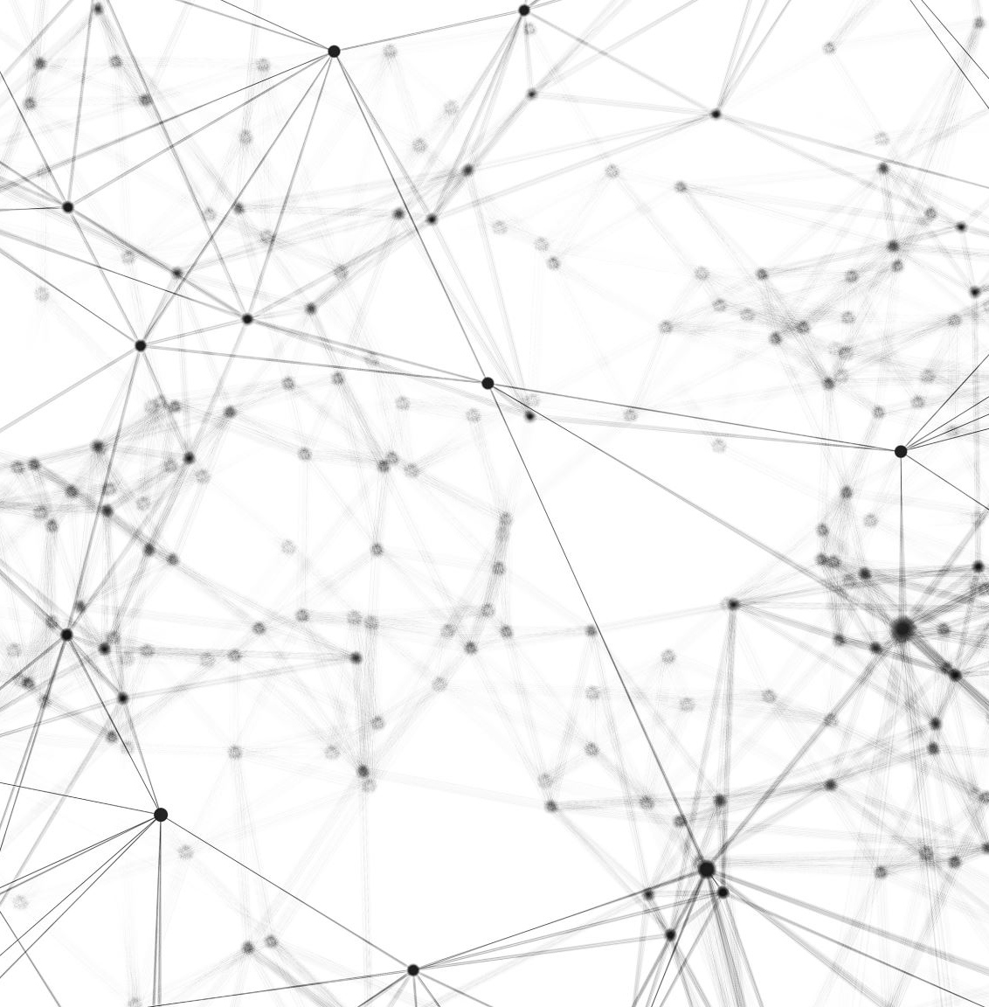
Multi – Style Generative Network with Transfer Learning
Chandra Devarakonda(9092-2981)
Suprith Reddy Gurudu (9961-2134)
Sanjay Reddy Banda (5878-2239)

Slide 2
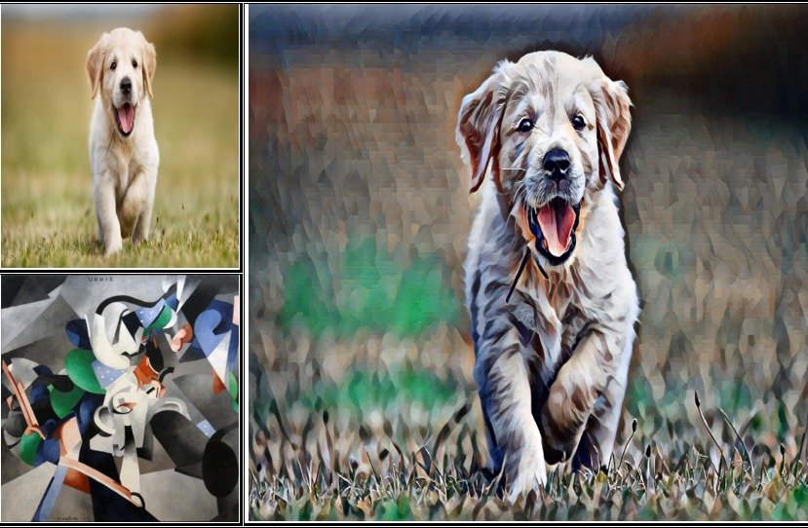
Style Transfer
Extract style from style target
Extract content from content image
Superposing style on content image

Slide 3
Network Architecture
Transformation Network
Co-Match network
Loss Network

Slide 4
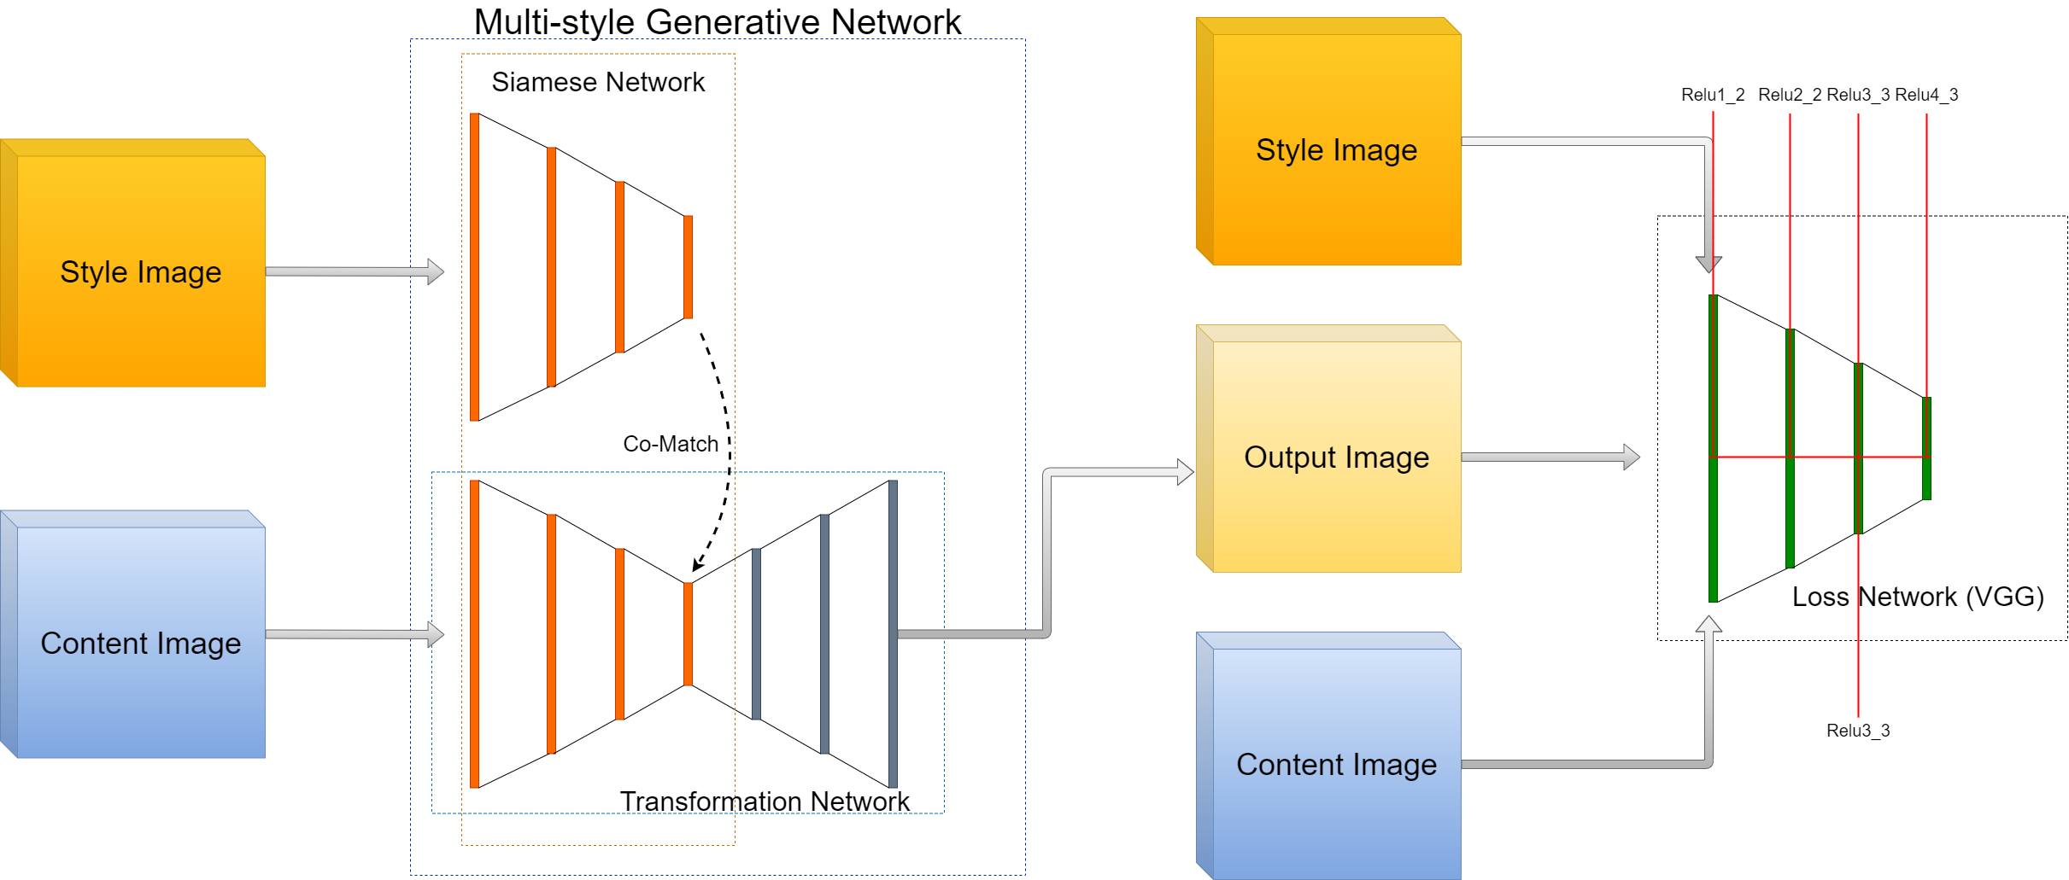
Architecture

Slide 5
Transformation Layer
Generative network for multi-style transfer
Input: content image and output of co-match layer
Down sampling
Up sampling

Slide 6
Feature Statistics
Feature statistics are obtained by down sampling
Content image feature statistics are obtained through loss network

Slide 7
Co-Match Layer
To extract style from the style image
Second order feature statistics or Gram Matrix
Cholesky Decomposition

Slide 8
Gram Matrix
Second order feature statistics
Measure the degree of correlation between channels
Better compared to Mean and Variance of CNN feature map

Slide 9
Loss Network
Style transfer problem: No golden sample
Pre-trained VGG model
Input: transformation network output, style image and content image.

Slide 10
Losses
Content loss
Style loss

Slide 11
Final Results

Slide 12
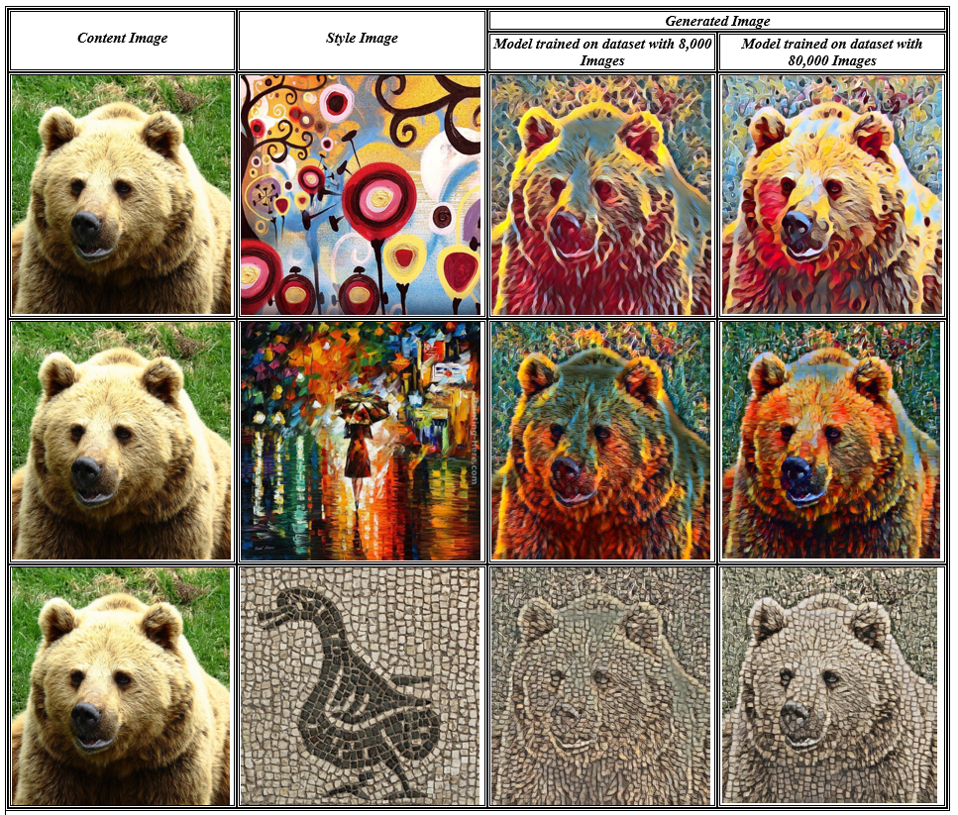

Slide 13
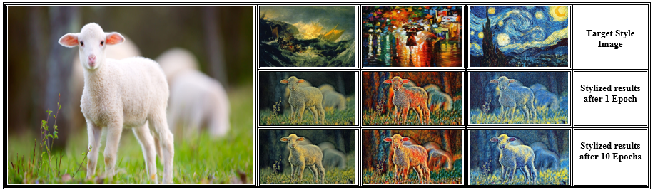

Slide 14

Thank You

